Slide 1
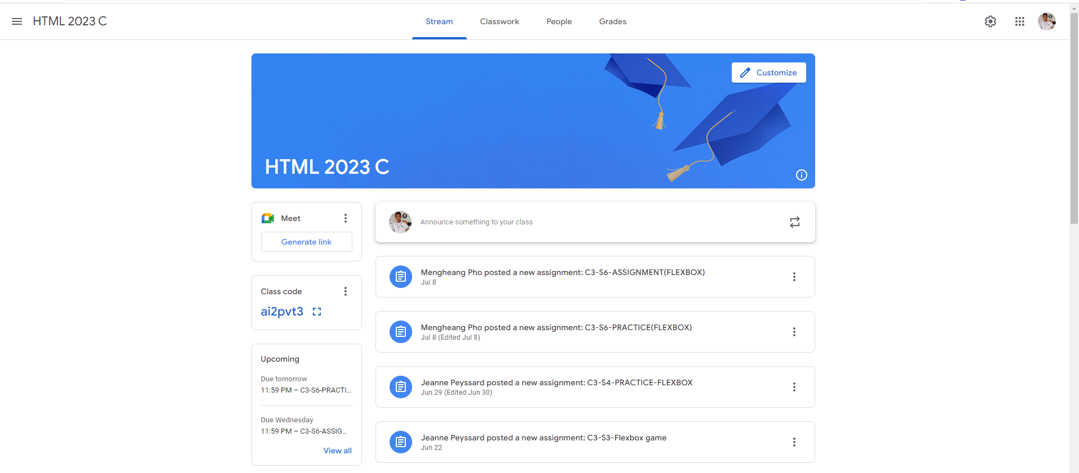
Identify root components of website below

Slide 2
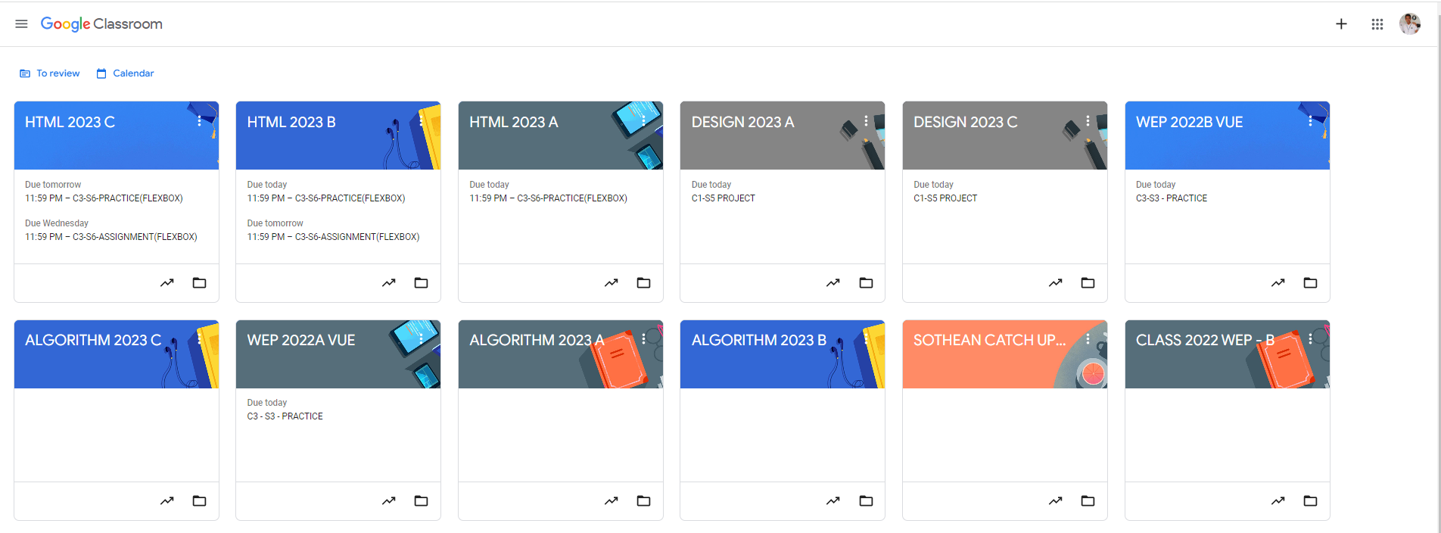
Root div
- Height: 100vh
content
nav
Flex: 0
header
Flex: 0
Flex: 1

Slide 3
Navigation
Main
Display: flex
Flex-direction: column

Slide 4



Nav-left
Nav-center
Nav-right
Display: flex
Flext-direction: row
menu
title
Display: flex
Flext-direction: row
stream
classwork
people
grades
Display: flex
Flext-direction: row
setting
More-opt
Profile-pic
Display: flex
Flext-direction: row

Slide 5
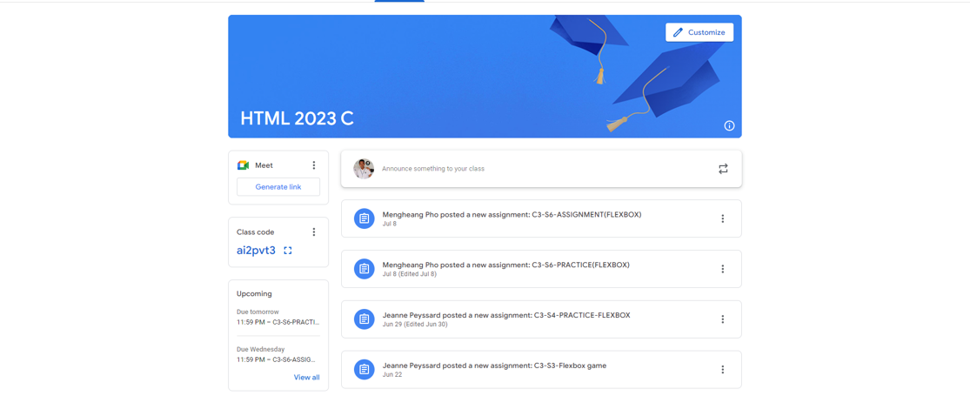
header
Main-content
Display: flex
Flex-direction: column

Slide 6

Header-left
Header-right
Display: flex
Flex-direction: row

Slide 7




Header-right-top
Header-right-bottom
Display: flex
Flex-direction: column
Header-right-top
Display: flex
Justify-content: end
Header-right-bottom
Display: flex
Justify-content: end
Align-items: end
Header-left
Display: flex
Align-items: end

Slide 8
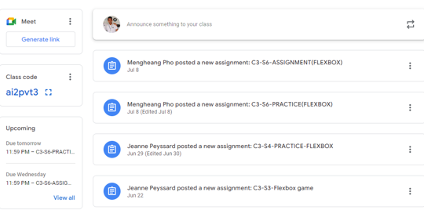
sidebar
content
Display: flex
Flex-direction: row

Slide 9
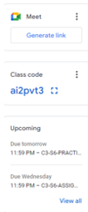
meet
Class-code
upcoming
Display: flex
Flex-direction: column

Slide 10


meet-top
meet-bottom
Display: flex
Flex-direction: column
meet-top-left
meet-top-right
Display: flex
Flex-direction: row
Class-code-top
class-code-bottom
Display: flex
Flex-direction: column
Class-code-top-left
Class-code-top-right
Display: flex
Flex-direction: row

Slide 11
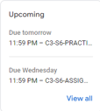

head
assignment-detail
assignment-info
view
Display: flex
Flex-direction: column
deadline
Display: flex
Flex-direction: column
Assignment-name

Slide 12
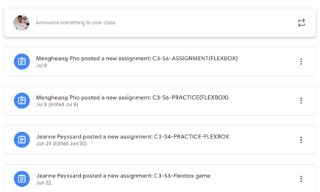
announcement
assignment
Display: flex
Flex-direction: column

Slide 13


Left-side
Right-side
Display: flex
Flex-direction: row
profile
text
Display: flex
Flex-direction: row

Slide 14

icon
Assignment-detail
opt
Display: flex
Flex-direction: row
info
Display: flex
Flex-direction: column
date

